Slide 1
Dairy Power Ltd.

Slide 2
We are dealing exclusively in milk & milk products
- since 2008
“Real Power with Real Taste”
“Delivering the best quality products to the end consumers”

Slide 3
Our Vision
Our Vision is to provide remunerative returns to the milk producer.
To serve and satisfy the interest of consumer by supplying quality products which are value for money.
To ensure consistent adherence to quality and standard parameters laid down by concerned competent authority.

Slide 4
INTRODUCTION
Dairy products manufactured at Dairy Power Limited plant with the latest technology and advanced machinery .
Currently Dairy Power as a brand has developed in the mother town Nashik & nearby markets.
We have at tremendous response from HORECA Industries, General Trades and also in an Institutions.
Our existing products Cow Milk, Toned Milk, Buffalo Milk, Ghee, Curd, Butter Milk, Shrikhand, Paneer, Lassi, chaas has captured a major part and encouraged us to expand our brand in dairy business.

Slide 5
PLANT CAPACITY
Total built up area of milk processing unit is 14,000 sq. ft , with installed milk storage capacity & Processing capacity of 3,00,000 litres per day.
We are already in an expansion phase of increasing plant capacity adding 2,50,000 litres per day.
Presently 3,00,000 litres of milk is handles per day, out of 1,00,000 litres of pouch milk is sold under the brand name of “Dairy Power”.
We have made enough provision of utilities and services to handle 3,00,000 litre of milk per day .

Slide 6
employment
The success of Dairy Power Brand is largely because of the vision of our MD Mr. Deepak Avhad .
Our employees are experts in their fields, and many of them have enjoyed a range of different roles from their years of experience.
The dairy industry offers an abundance of career opportunities. Within our organization, we enable our people to experience the various facts of the business, and to advance their careers with us.
We’re recognized as one of the top employers in our industry.
We invest heavily in training, professional development, and mentoring support programs. This dedication to our employees ensures we continue to motivate and inspire them, and to provide them with new opportunities which build their capability.

Slide 7
PROUREMENT
A strong procurement network of 140 chilling centers & 14 bulk coolers has been set up in Nashik district.
At the chilling centers we verify the quality with automated systems.
Then the milk is transported to bulk coolers to maintain cold chain and then to the factory via insulated vehicles.

Slide 8
Distribution
Milk and milk products are distributed to different parts of Maharashtra state i.e. Mumbai, Thane, Pune, Nashik, Malegaon, Jalgaon, Aurangabad, Kasara, Satana, and in other state like Vapi, Surat, Daman as well.
Milk is also supplied in bulk quantities to elite companies.
Dairy Power Ltd. Have their own insulated vehicles to maintain the cold chain of products.
Products are supplied to consumers via Dairy Power factory outlets or general trade.

Slide 9
Expansion
To expand the existing capacity of by products and to introduce new products such as Condensed Milk, WMP, SMP, Dairy Whiteners, Salted & unsalted Butter, Flavoured Milk & other dairy products in piped line

Slide 10
Expansion – Phase 1
Sr No | Product Name | Existing Capacity / Day | Expansion upto / Day
1 | Plant Area | 14,000 Sq. Ft. | 70,000 Sq. Ft.
2 | Milk Handling capacity | 50,000 ltrs. | 3,00,000 ltrs.
3 | Milk sold in own brand | 32,000 ltrs. | 1,00,000 ltrs.
4 | Ghee | 5 MT | 50 MT
5 | Curd | 10 MT | 25 MT
6 | Malai Paneer | 02 MT | 10 MT
7 | Shrikhand in three different flavor (Indian Sweet) | 01 MT | 3 MT
8 | Lassi | 1 MT | 2 MT
9 | Butter Milk | 3 MT | 8 MT

Slide 11
Expansion – Phase 2
In the process of expansion - phase 2 , we will be producing below mentioned products in the same factory premises :
Condensed Milk
Whole Milk Powder
Skimmed Milk Powder
Dairy Whiteners
Salted & Unsalted Butter
Flavoured Milk
Fresh Cream

Slide 12
Manufacturing
The manufacturing plant is located in Saikheda, Nashik District.
Acute quality check is done by professionals in quality control lab at the factory .
The complete process of filtration, homogenization, pasteurization, storage and packaging is automated.
A part of processed milk is sent for byproducts. Special care of hygiene has been taken in the plant.

Slide 13
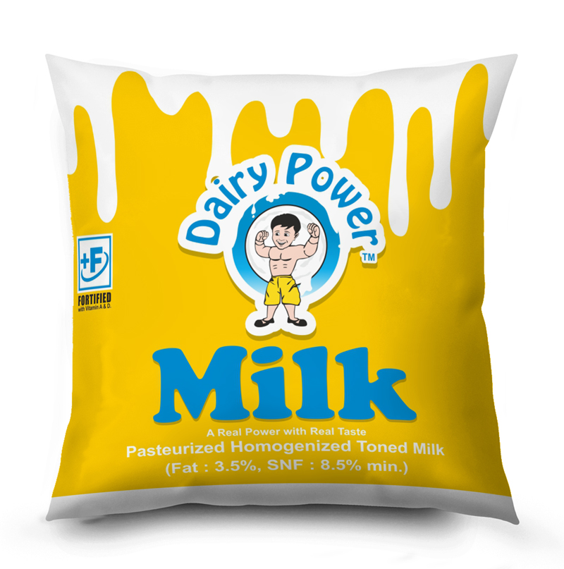
COW MILK
Cow milk is prepared from natural fresh cow milk.
Packaging Size : 200 ml
250 ml
500 ml in pouch
1000 ml
5000 ml

Slide 14
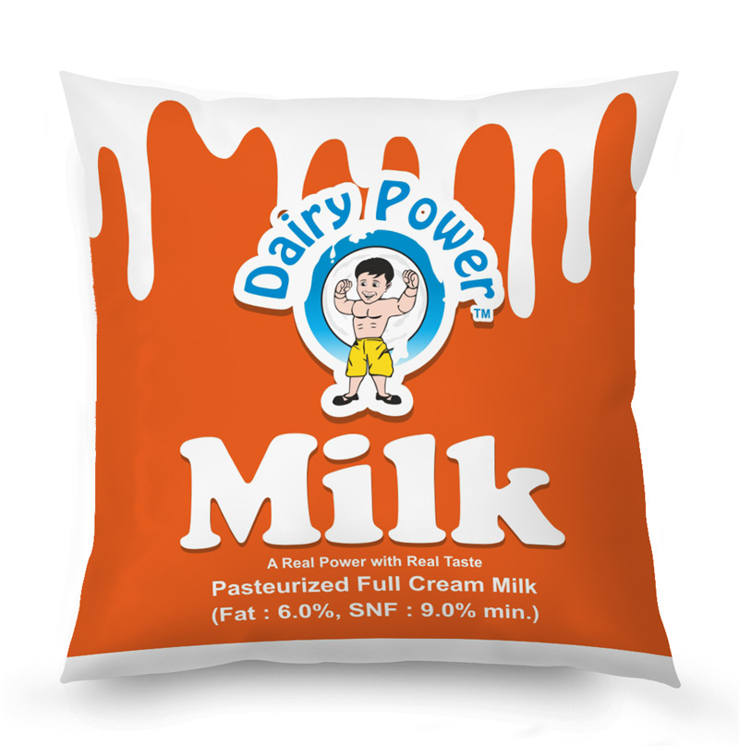
Buffalo Milk
Full creamed milk is prepared from natural fresh buffalo milk.
Packaging Size : 500 ml
1000 ml in pouch
5000 ml

Slide 15
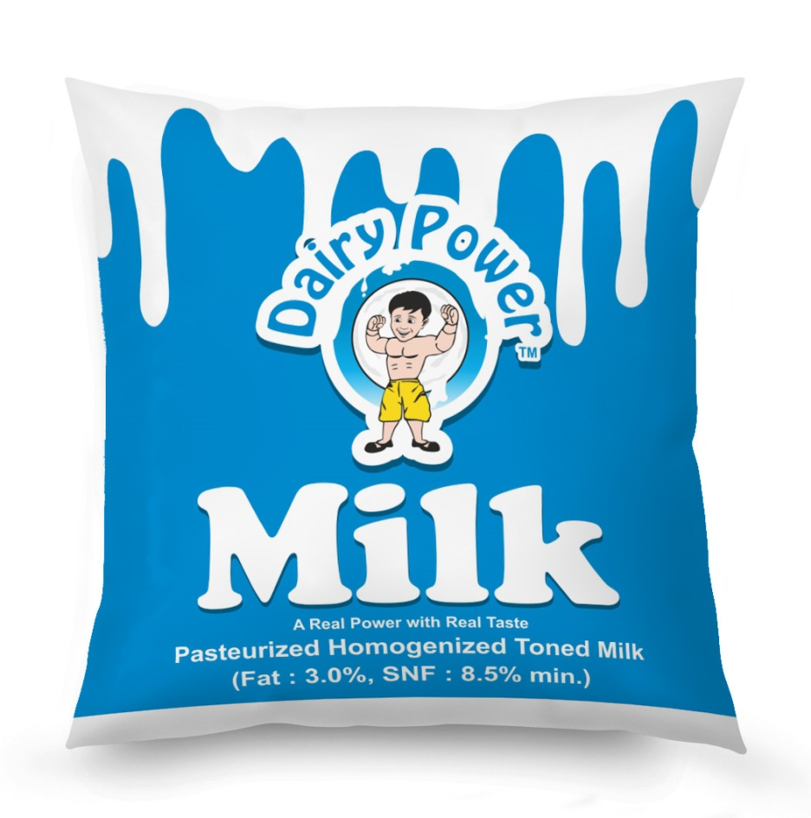
Toned Milk
Toned milk is made from natural fresh cow milk.
Packaging Size : 200 ml
250 ml
500 ml in pouch
1000 ml
5000 ml

Slide 16
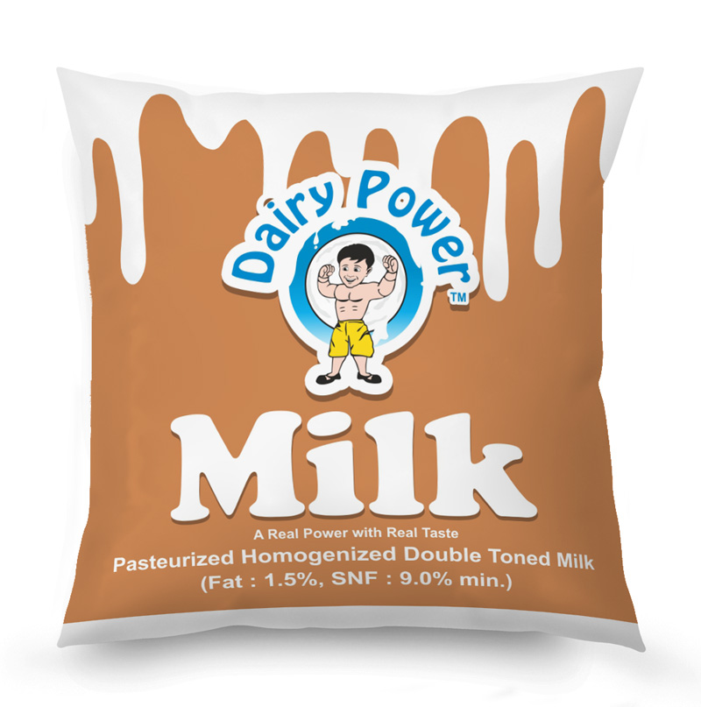
Double Toned Milk
Double toned milk is made from natural fresh cow milk.
Packaging Size : 200 ml
250 ml
500 ml in pouch
1000 ml
5000 ml

Slide 17
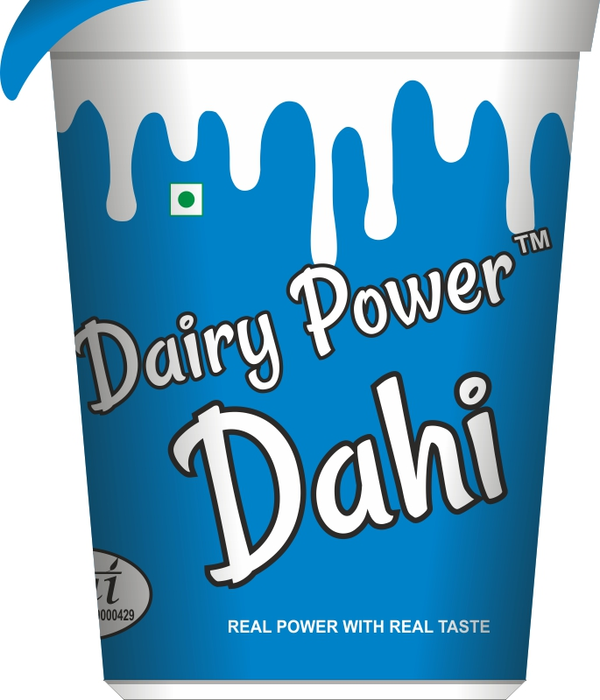
Dahi / Curd
Dahi or Curd is the product obtained from pasteurised milk by souring harmless but healthy/beneficial bacterial culture.
Packaging Size : 85 gm
200 gm in cup
400 gm
2 kg
5kg in tub
200 gm
1000 gm in pouch
5000 gm

Slide 18
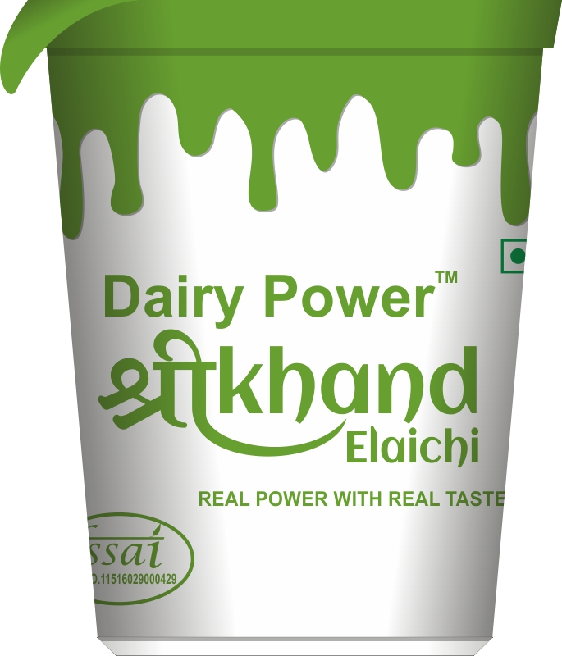
Shrikhand – Elaichi
Shrikhand – Elaichi is a semi – soft, sweetish, sour fermented milk product prepared from curd with addition of sugar and Elaichi.
Packaging Size : 100 gm
250 gm in cup
500 gm

Slide 19
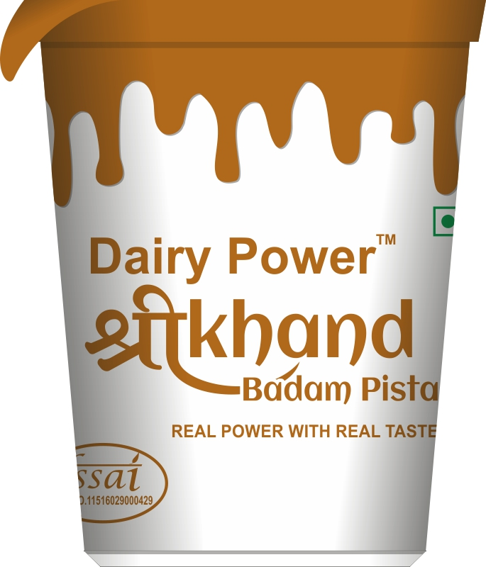
Shrikhand – Badam Pista
Shrikhand – Badam Pista is a semi – soft, sweetish, sour fermented milk product prepared from curd with addition of sugar and dry Fruits.
Packaging Size : 100 gm
250 gm in cup
500 gm

Slide 20
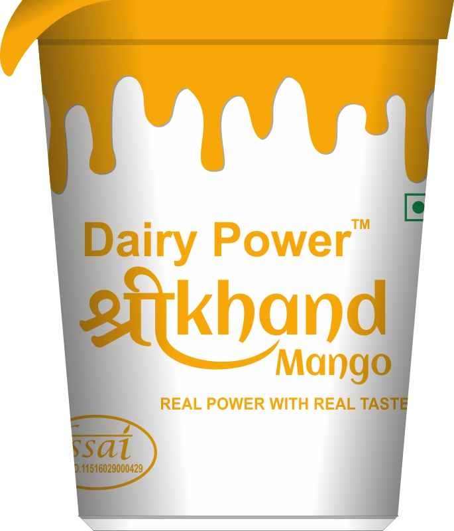
Shrikhand – Mango
Shrikhand – Mango is a semi – soft, sweetish, sour fermented milk product prepared from curd with addition of sugar and mango pulp.
Packaging Size : 100 gm
250 gm in cup
500 gm

Slide 21
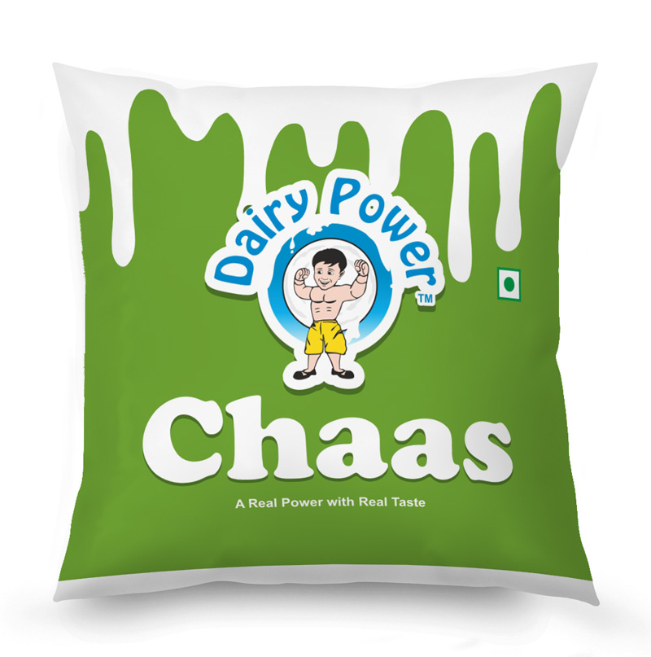
Chaas
Chass is the product obtained by churning pasteurized dahi and chilled water mixture.
Packaging Size : 400 ml
500 ml
in pouch

Slide 22
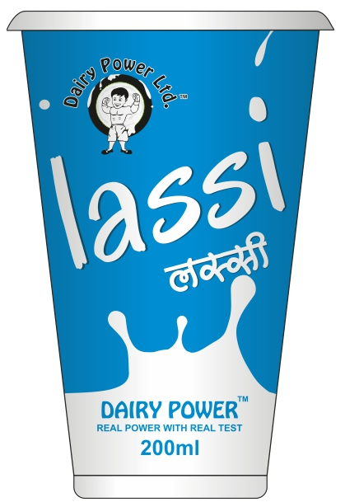
Lassi
Lassi is the product obtained by churning pasteurized dahi, Sugar & chilled water mixture.
Packaging Size : 200 ml - in pouch
200 ml - in cup

Slide 23
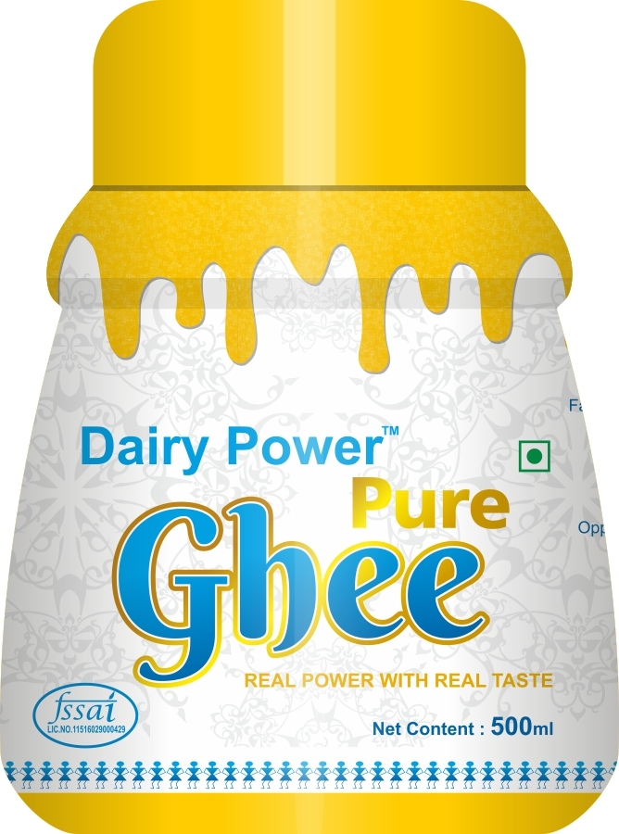
Ghee
Ghee is pure clarified fat milk, cream.
Double Boiled Ghee with a delighted fragrance.
Ghee is the good source of energy.
Packaging Size : 200 ml
500 ml in jar
1000 ml
15 ltrs - in tin

Slide 24
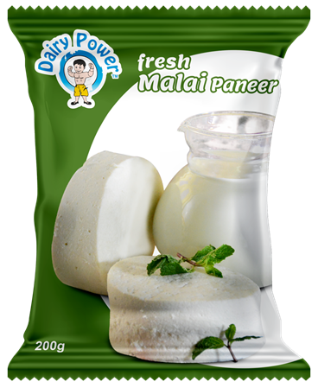
Fresh Malai Paneer
Fresh Malai Paneer is the product obtained by fresh milk.
It’s in slabs.
Packaging Size : 200 gm
500 gm
01 kg
05 kg
in multilayer pouch

Slide 25
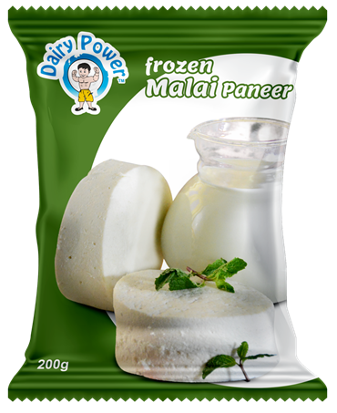
Frozen Malai Paneer
Frozen Malai Paneer is the product obtained by Milk.
It’s in 10 mm & 20 mm cubes
Packaging Size : 200 gm
500 gm
01 kg
05 kg
in multilayer pouch

Slide 26
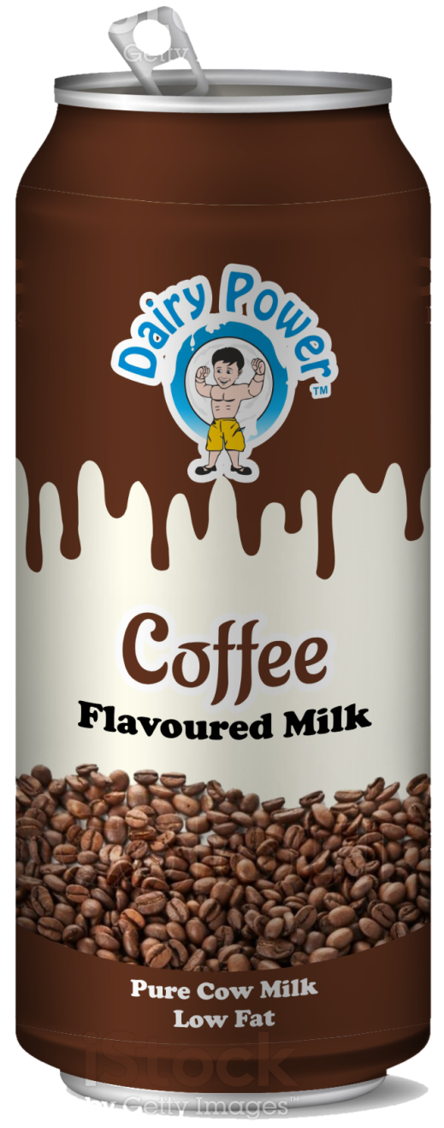
Flavoured Milk - Coffee
Flavoured milk is a drink made with cow milk, sugar ,flavouring of Coffee. Which is enriched with vitamins and calcium
Packaging Size : 200 ml in tin

Slide 27
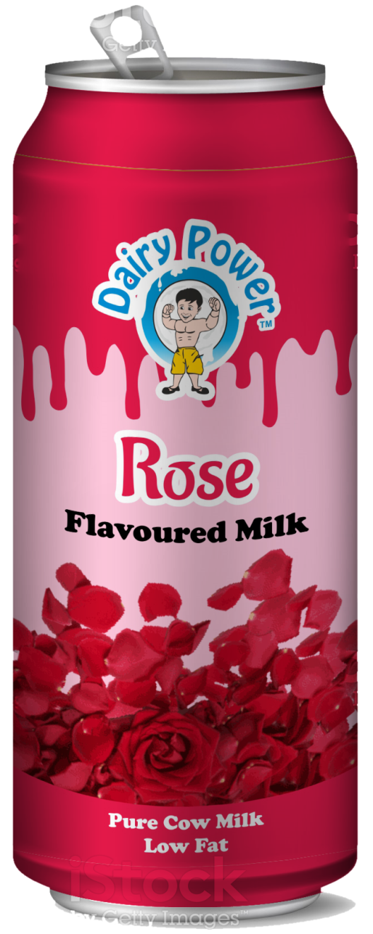
Flavoured Milk - Rose
Flavoured milk is a drink made with cow milk, sugar ,flavouring of Rose and almond flakes. Which is enriched with vitamins and calcium
Packaging Size : 200 ml in tin

Slide 28
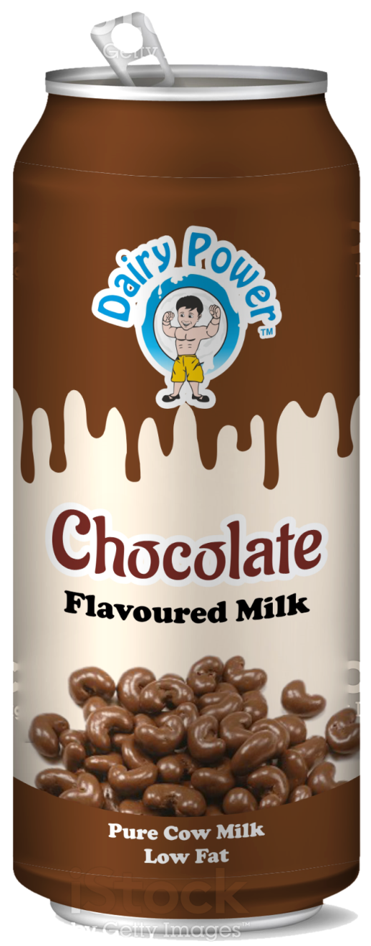
Flavoured Milk - Chocolate
Flavoured milk is a drink made with cow milk, sugar ,flavouring of Chocolate. Which is enriched with vitamins and calcium
Packaging Size : 200 ml in tin

Slide 29
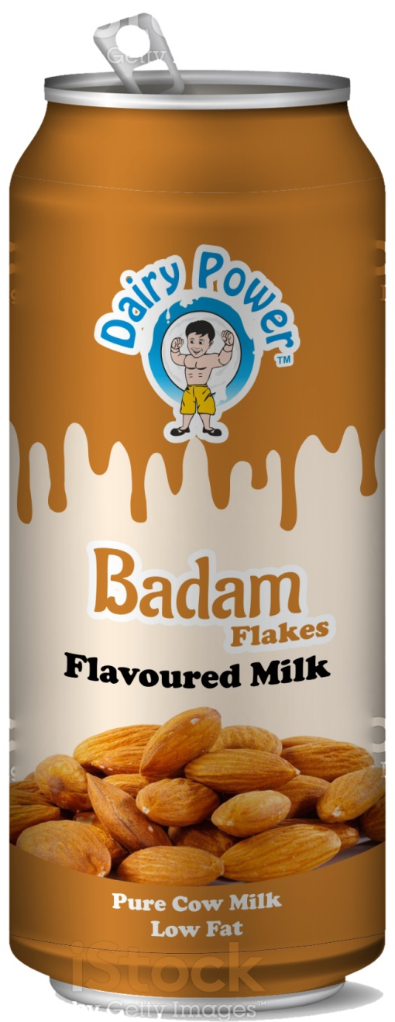
Flavoured Milk - Badam
Flavoured milk is a drink made with cow milk, sugar ,flavouring of almond and almond flakes. Which is enriched with vitamins and calcium
Packaging Size : 200 ml in tin

Slide 30
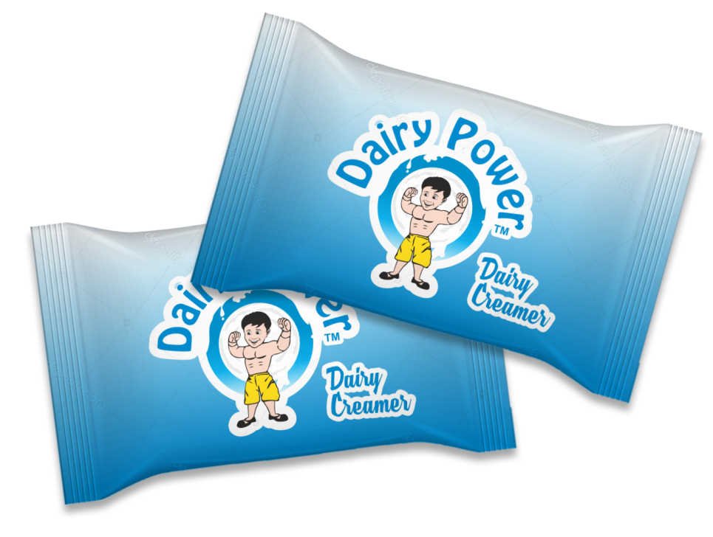
Dairy Creamer
Dairy Creamer is made by evaporating milk to dryness.
One purpose of drying milk is to preserve it for longer time.
It has a far longer shelf life than liquid milk and does not need to be refrigerated, due to its low moisture content.
Packaging Size : 10 gm - in sachet
1 kg - in pouch

Slide 31
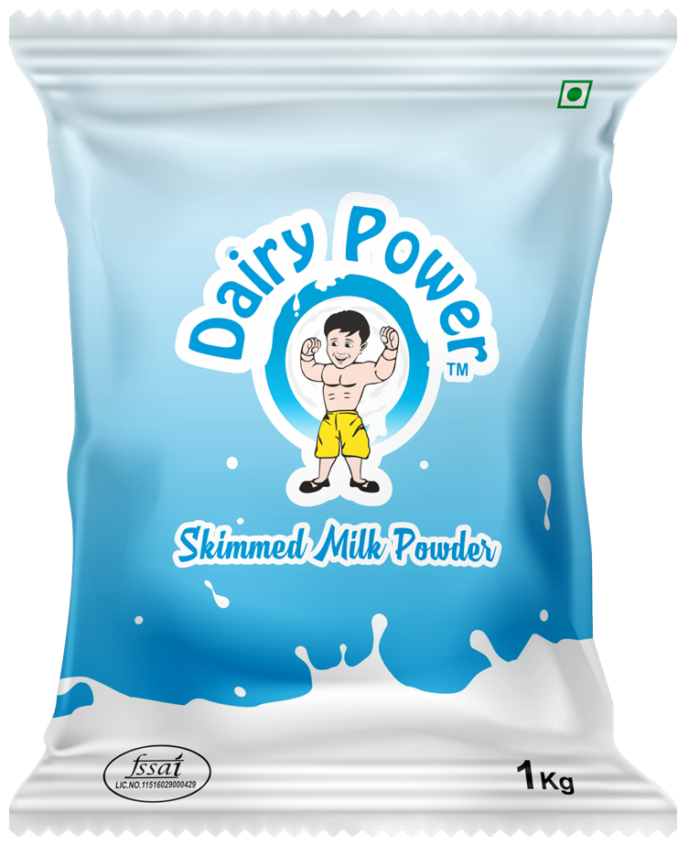
Skimmed milk Powder ( SMP )
Skim Milk Powder is obtained by removing water from pasteurized skim milk.
Packaging Size : 1 kg - in pouch
25 kg – ginni bags

Slide 32
Salted & Unsalted Butter
Butter is a pale yellow edible fatty substance made by churning cream and used as a spread or in cooking.
It’s without salt & with salt as well.
Packaging Size : 10 gm - in chiplet

Slide 33
Currently Available Markets
Maharashtra
Goa
Gujarat
Bangalore
Oman
UAE
Qatar
Kuwait

Slide 34
Soon will be available at these markets beyond India
United States
Malaysia
Singapore
Saudi Arabia
Bahrain

Slide 35
?
Why dairy power ltd.
To Comply with the rapidly changing technology our unit is well equipped with the latest plant and machineries which facilitates and enables us to cater to the growing needs of esteemed customers.
Our constant endeavor is to make quality and promptness an integral part of the entire value chain process.
With our logistic division which includes company owned tankers and insulated milk vans.
The Company is well equipped to satisfy the distributor's needs by timely and sufficient deliveries.
All the products are value for money. The special ingredient of the products is it’s hygiene.

Slide 36
Dairy Power Ltd. location
Head Office : Shop no 3, Samarth Heights,
Opp. Sudarshan Lawns,
Indira Nagar, Nashik – 422009
Factory : Gat No 555, at Songaon,
Post Saikheda, Tal Niphad, Nashik, Maharashtra - 422210.

Slide 37
“Real Power with Real Taste”
www.dairypower.in

